Slide 1
Feedme

Slide 2




Slide 4


Slide 5
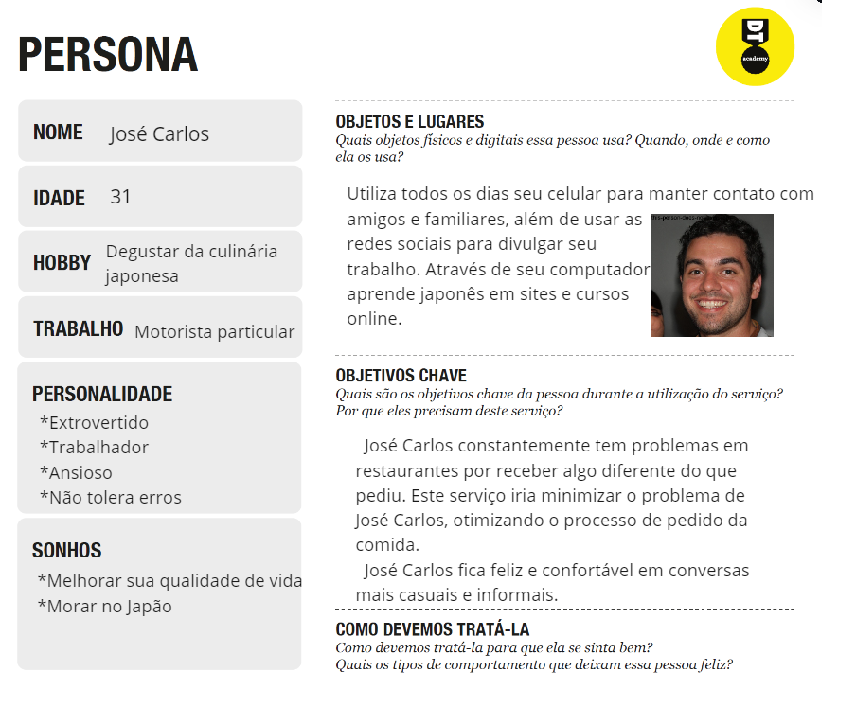

Slide 6


Slide 7
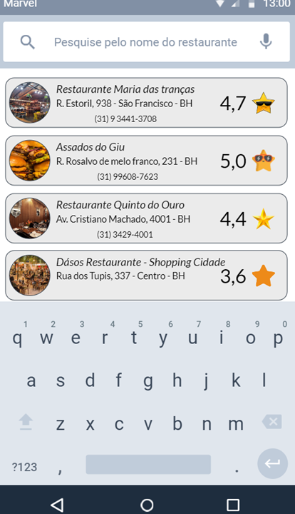

Slide 8


Slide 9
